Slide 1

Tractortek sales report
Capstone 1 for TEKsystems Bootcamp
Presented by: Tucker Watson
3/11/2021

Slide 2
How I went about this project
Planning:
Database creation & Population Took a lot of the time to find a way that worked with Web App
Web Application Used framework from the Puppy database
Linking Excel to SQL and Dashboard Had to plan how my Dashboard would look & Created pivot tables according to the data I wanted to show
Created Jupyter notebook as a database checker

Slide 3
Web Application Demo

Slide 4
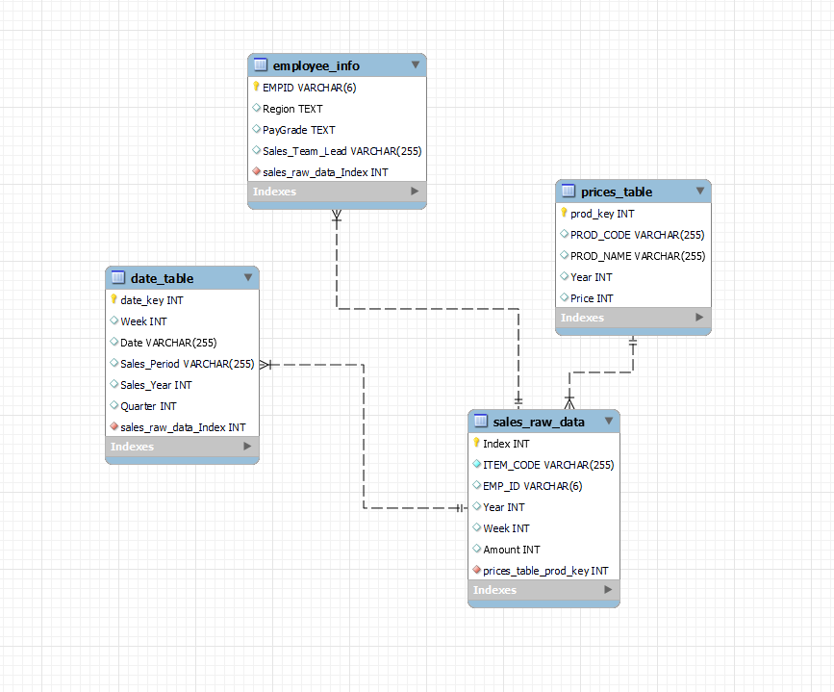
SQL Database EER Diagram
This Subtitle is Arial in Light Orange
Database layout - After creating and populating my four tables I made an EER Diagram and connected the tables

Slide 5
Dashboard Demo

Slide 6
Jupyter Notebook

Slide 7
Thanks for the time!
Questions?

